Slide 1
Project 3 - Medical Inventory Optimization and Forecasting

Slide 2
Contents
Topic research
Business & data understanding
AWS Glue DataBrew data preprocessing: exploratory data analysis (EDA), data cleaning/data preparation
Data visualization, analysis with AWS QuickSight
Notes:
Change

Slide 3
Project Overview and Scope
Medical Inventory Optimization and Forecasting:
Drugs at the store are random, we have to arrange medicines and check drugs stock weekly. Forecasting of medicine in pharmacy should be done based on the season, doctor prescription, medicine company and patients issues.
Objectives:
Minimize medicine bounce rate.
Minimize medicine overstocking.
Maximize the maintenance of minimum stock level for emergency medicines.
Goal:
To avoid the shortage of the medicine.
Time to deliver the medicine should be less.

Slide 4
Business Problem
Ineffective medical inventory management which leading to medicine overstocking and high bounce rate, as well as insufficient minimum stock level in emergency medicines.

Slide 5
Objective
Constraints
Minimize medicine bounce rate.
Minimize medicine overstocking.
Maximize the maintenance of minimum stock level for emergency medicines.
Minimize understanding in doctor prescription and patients issues.
Minimize understanding in medicines shelf life and production schedules.
Minimize effective delivery logistics.

Slide 6
CRISP-ML(Q) Methodology
Business Understanding and Data Understanding
Data Preparation
Data visualization, analysis with data visualization/business intelligence tool
Model Building
Evaluation
Model Deployment
Monitoring and Maintenance

Slide 7
Technical Stacks
Amazon Web Services (AWS):
AWS S3 (storage)
AWS Glue DataBrew (data cleaning and data preparation)
AWS QuickSight (data visualization)
Others:
Microsoft Office 2021
Microsoft Edge
Microsoft Paint
Chat GPT
draw.io

Slide 8
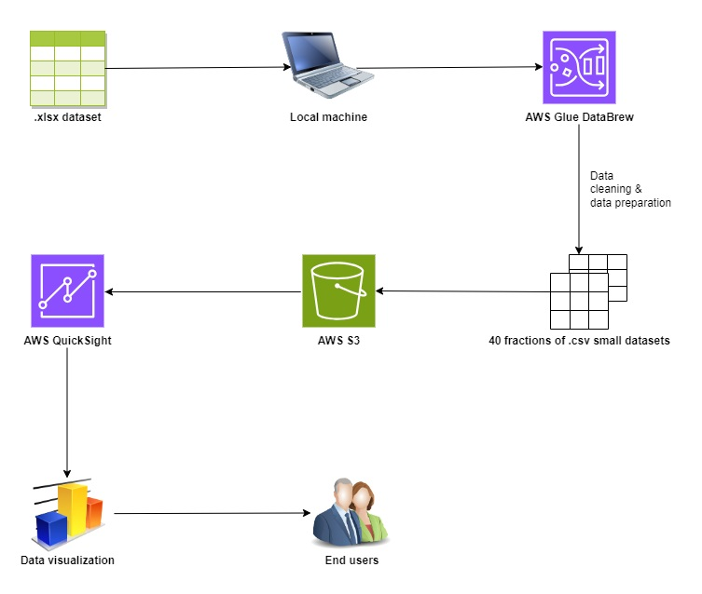
Project Architecture

Slide 9
Data Collection and Understanding
No. | Column Name | Description | Data-Type
1 | Typeofsales | Indicates whether it's a sale or a return. | String: qualitative, nominal
2 | Patient_ID | The ID of the patient involved in the transaction. | Integer: qualitative, nominal
3 | Specialisation | Transaction related specialization, likely is the specific area or field of the medicine. | String: qualitative, nominal
4 | Dept | The department involved. | String: qualitative, nominal
5 | Dateofbill | The transaction date. | String: qualitative, nominal
6 | Quantity | The quantity sold. | Integer: quantitative, ratio
7 | ReturnQuantity | The quantity returned (if any). | Integer: quantitative, ratio
8 | Final_Cost | The final product cost. | Float: quantitative, ratio
9 | Final_Sales | Amount paid by the customer for the products purchased. | Float: quantitative, ratio
10 | RtnMRP | Likely return maximum retail price, the highest price at which the returned product could have been sold in a retail setting. | Float: quantitative, ratio
11 | Formulation | Represent different formulations of drugs. | String: qualitative, nominal
12 | DrugName | The name of the drug. | String: qualitative, nominal
13 | SubCat | Subcategories of drugs based on physical forms. | String: qualitative, nominal
14 | SubCat1 | Subcategories of drugs based on applications (purpose and usage). | String: qualitative, nominal

Slide 10
System Requirements
Device Requirements:
Processor 12th Gen Intel(R) Core(TM) i3-1215U 1.20 GHz
Installed RAM 8.00 GB (7.69 GB usable)
Storage Device 256GB M.2 PCIe NVMe Solid State Drive
System type 64-bit operating system, x64-based processor
Windows Requirements:
Edition Windows 11 Home Single Language
Version 22H2
Installed on ‎6/‎18/‎2023
OS build 22621.2428
Experience Windows Feature Experience Pack 1000.22674.1000.0

Slide 11
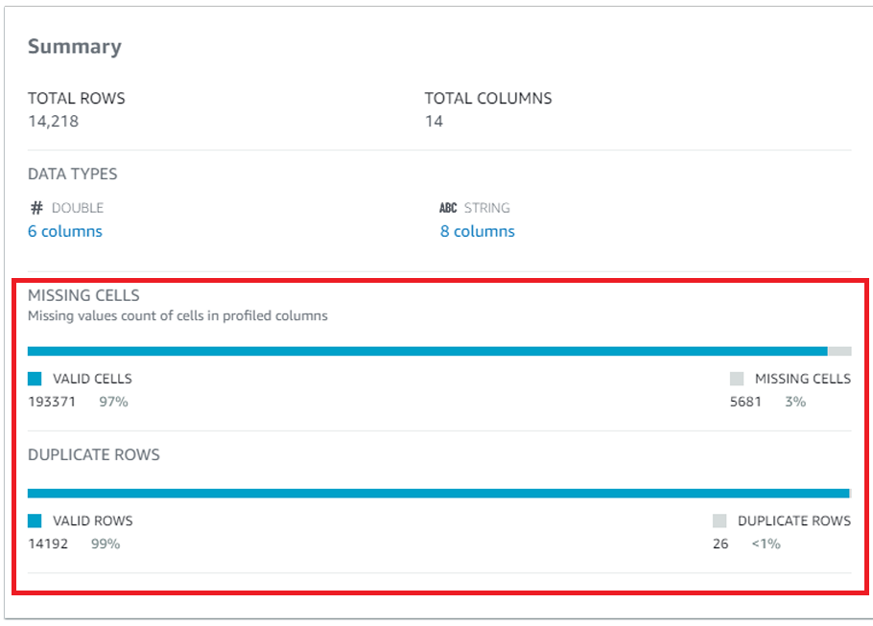
Exploratory Data Analysis [EDA]
Overview:
Notes:
EDA is used for seeing what the data can tell us before the modeling task.
Change

Slide 12
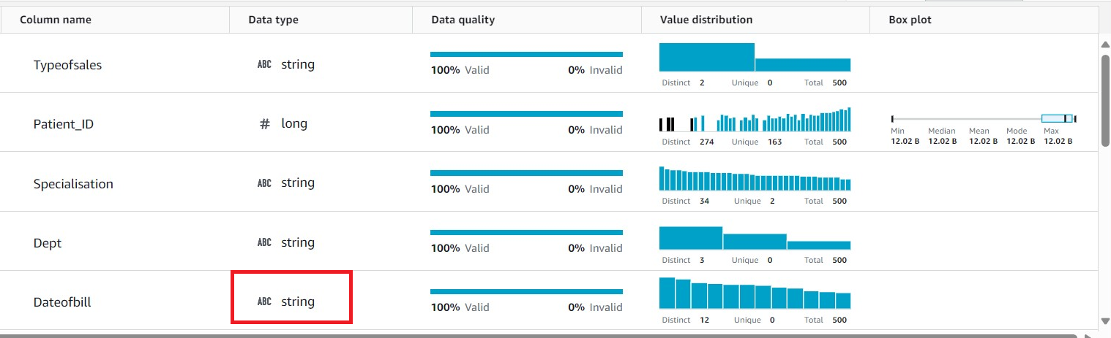
Exploratory Data Analysis [EDA]
Columns:
Notes:
EDA is used for seeing what the data can tell us before the modeling task.
Change

Slide 13
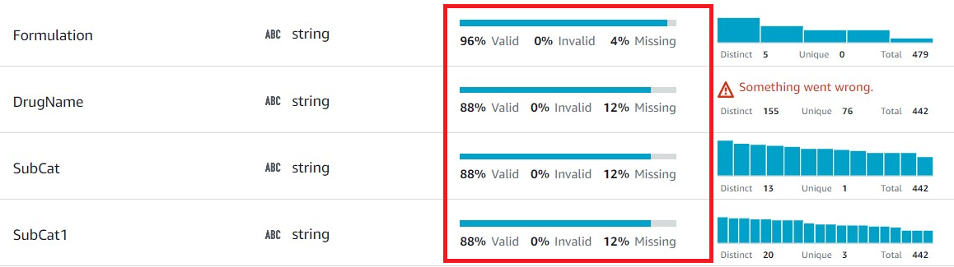
Exploratory Data Analysis [EDA]
Columns:
Notes:
EDA is used for seeing what the data can tell us before the modeling task.
Change

Slide 14
Exploratory Data Analysis [EDA]
EDA Conclusion:
As there are missing values, duplications & incorrect data type found in the dataset, a subsequential data cleaning/data preparation is required before visualization.
Notes:
EDA is used for seeing what the data can tell us before the modeling task.
Change

Slide 15
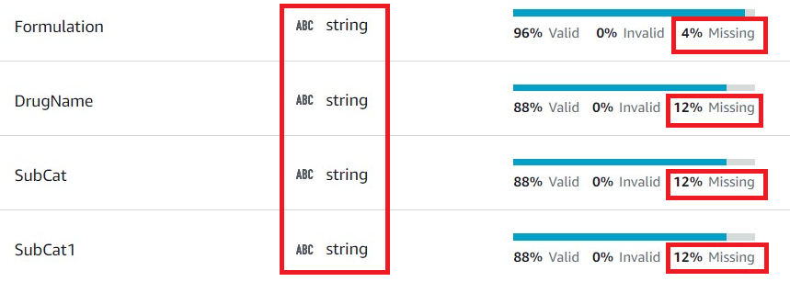
Missing Values Observation
No missing value found in all numerical columns, including “Dateofbill”.
Missing values which found in the last 4 categorical columns were not removed, but instead were marked as “unknown” in the respective feature for these reasons:
a) Data distribution and integrity preservation for better visualization approach.
b) The possibility in missing records identification or categorization along the visualization process.

Slide 16
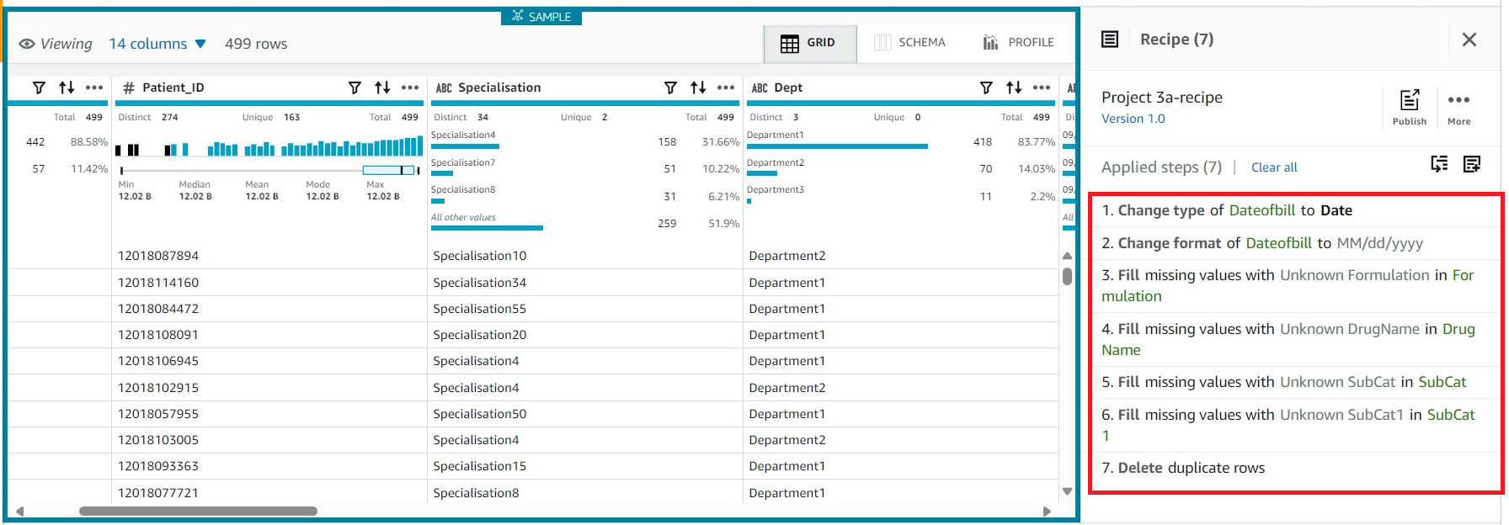
Data Cleaning
Data Cleaning/Data Preparation Steps:
Notes:
Keep observations

Slide 17
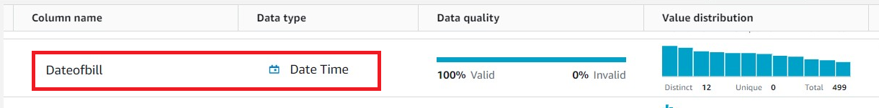
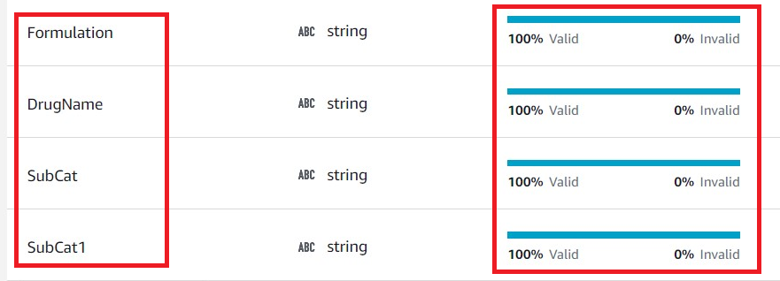
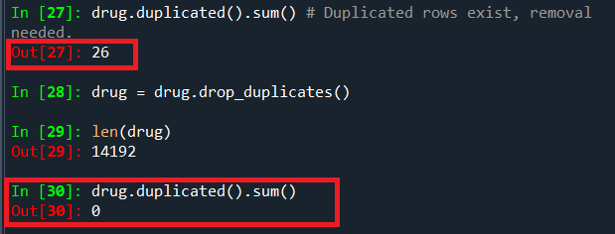
Exploratory Data Analysis [EDA]
After Data Cleaning/Data Preparation:
Notes:
EDA is used for seeing what the data can tell us before the modeling task.
Change

Slide 18
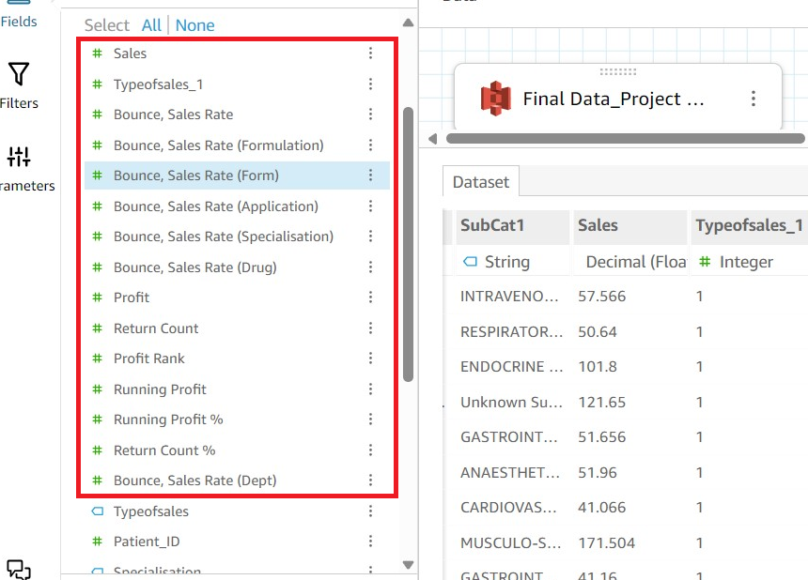
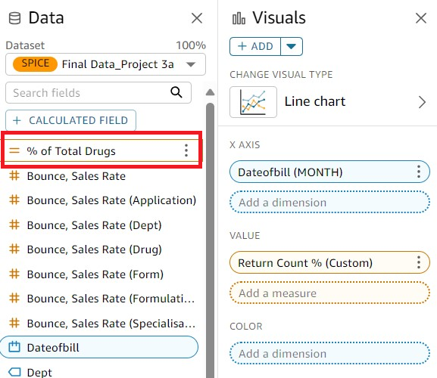
Data Visualization
AWS QuickSight Custom Calculated Fields for Charts Plotting:

Slide 19
Data Visualization
Visualization Overview:
Medicine bounce rate analysis.
Medicines sales trend analysis.
Top sales and least sales medicines identification.
Missing medicine records identification/categorization.

Slide 20
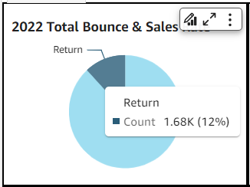
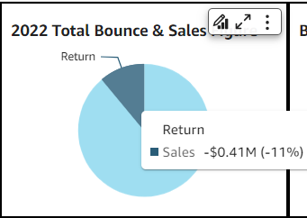
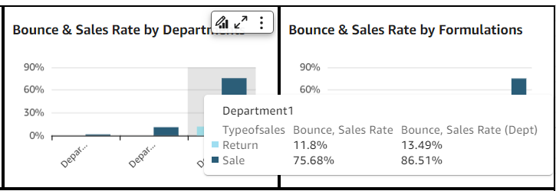
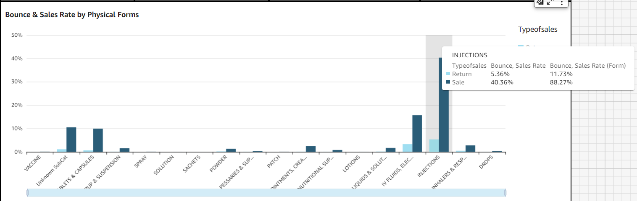
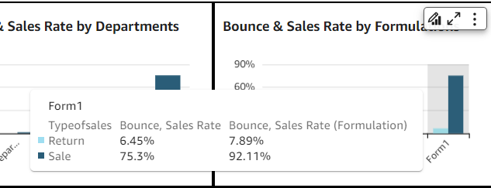
Data Visualization [Bounce Rate]
Notes:
Keep observations

Slide 21
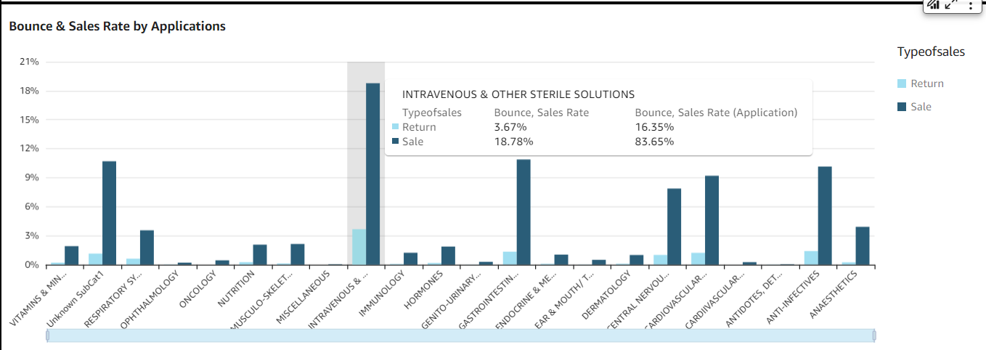
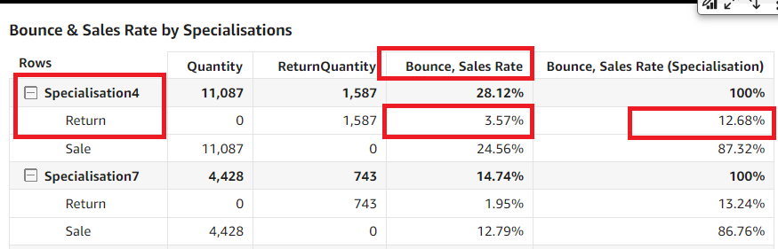
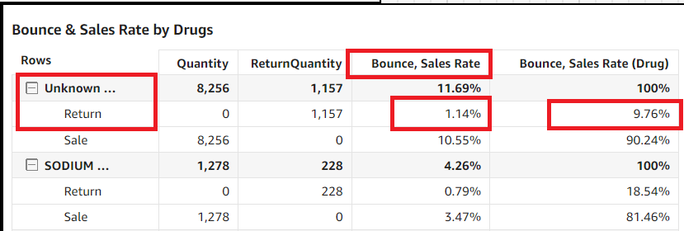
Data Visualization [Bounce Rate]
Notes:
Add graphical

Slide 22
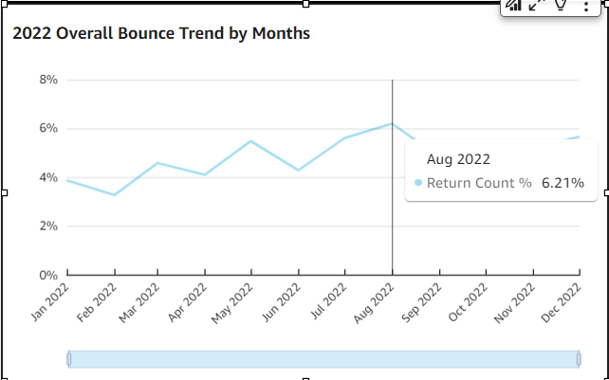
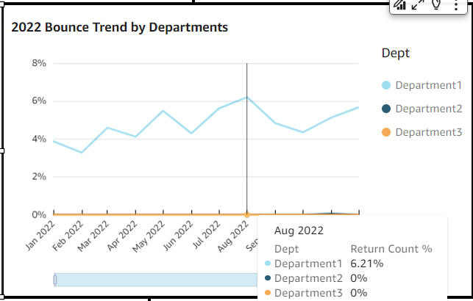
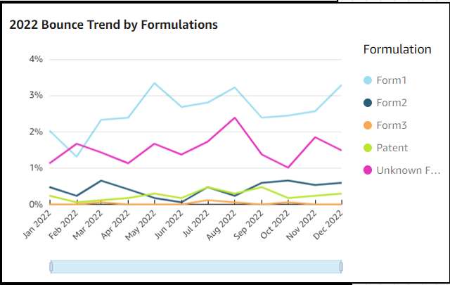
Data Visualization [Bounce Trend]
Department 1
medicines has
contributed >90%
bounce.
Formulation 1 medicines has highest bounce, followed by Unknown Formulation medicines (missing values), which is having some bounce pattern similarity to Formulation 1:
It is possible that most unknowns are Formulation 1.
Notes:
Piee

Slide 23
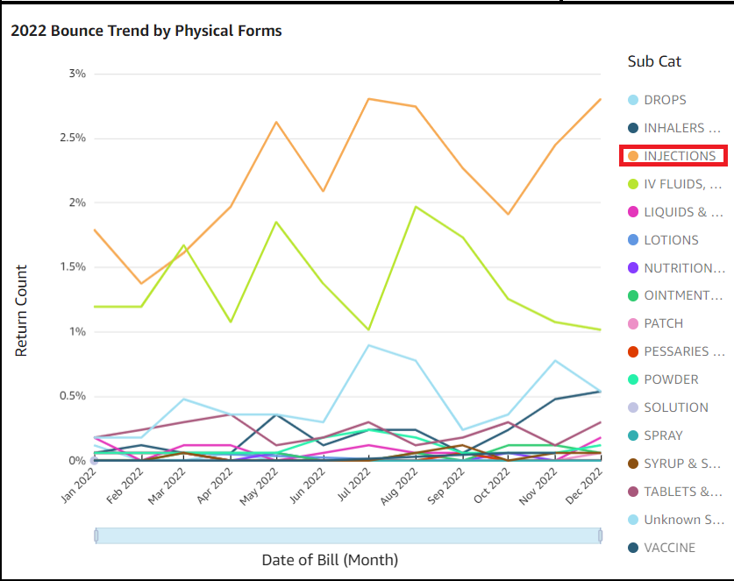
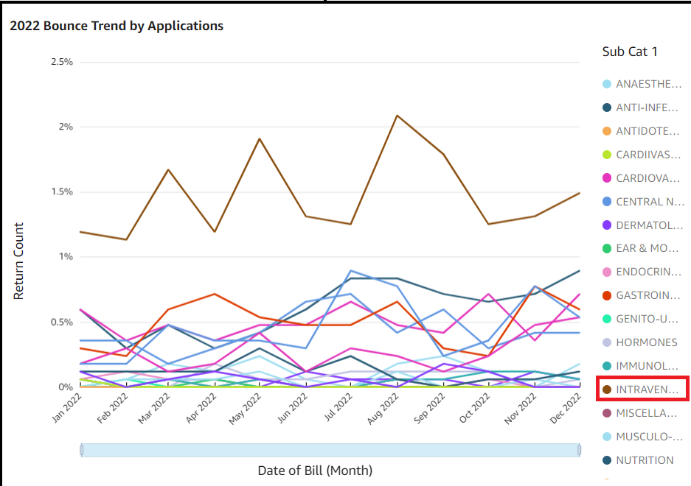
Data Visualization [Bounce Trend]
Notes:
Piee

Slide 24
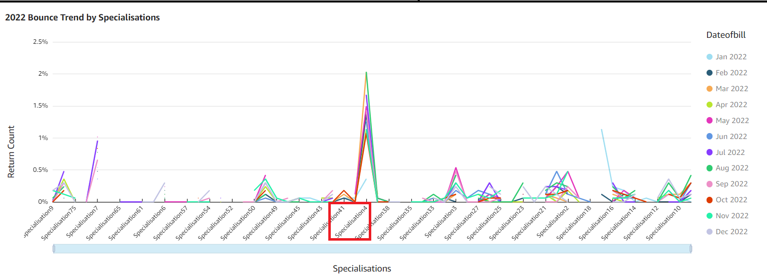
Data Visualization [Bounce Trend]
Notes:
Piee

Slide 25
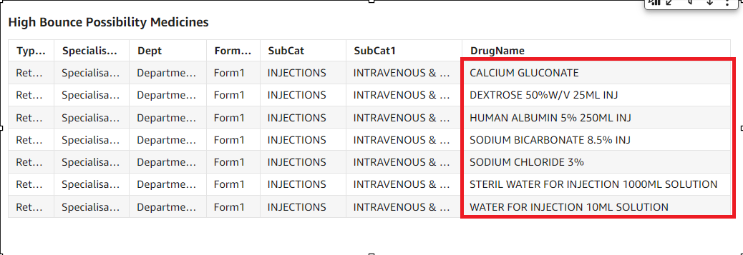
Data Visualization [Bounce Trend]
High bounce possibility medicines, concluded from bounce trend visualizations:
Highest medicine bounce month: August
Notes:
Piee

Slide 26
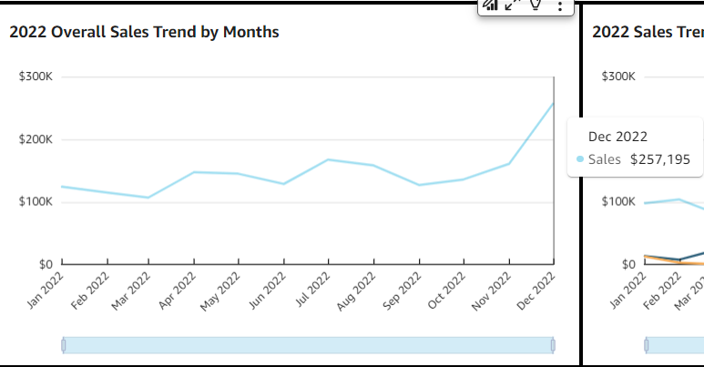
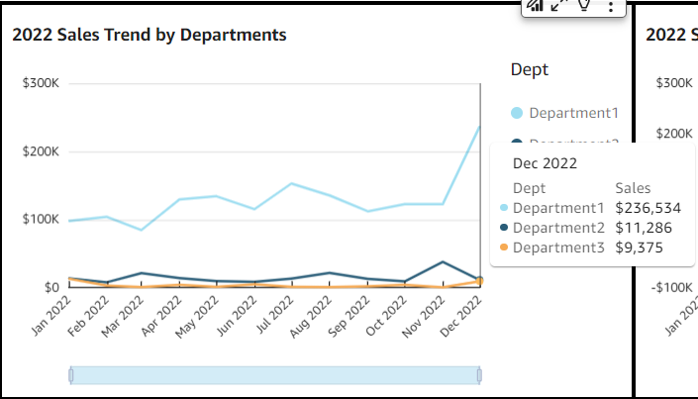
Data Visualization [Sales Trend]
Department 1 and Formulation 1 possessed some sales pattern similarity to 2022 overall sales trend:
>50% of 2022 sales were contributed by medicines of these groups, despite their highest bounce rate.
Notes:
Piee

Slide 27
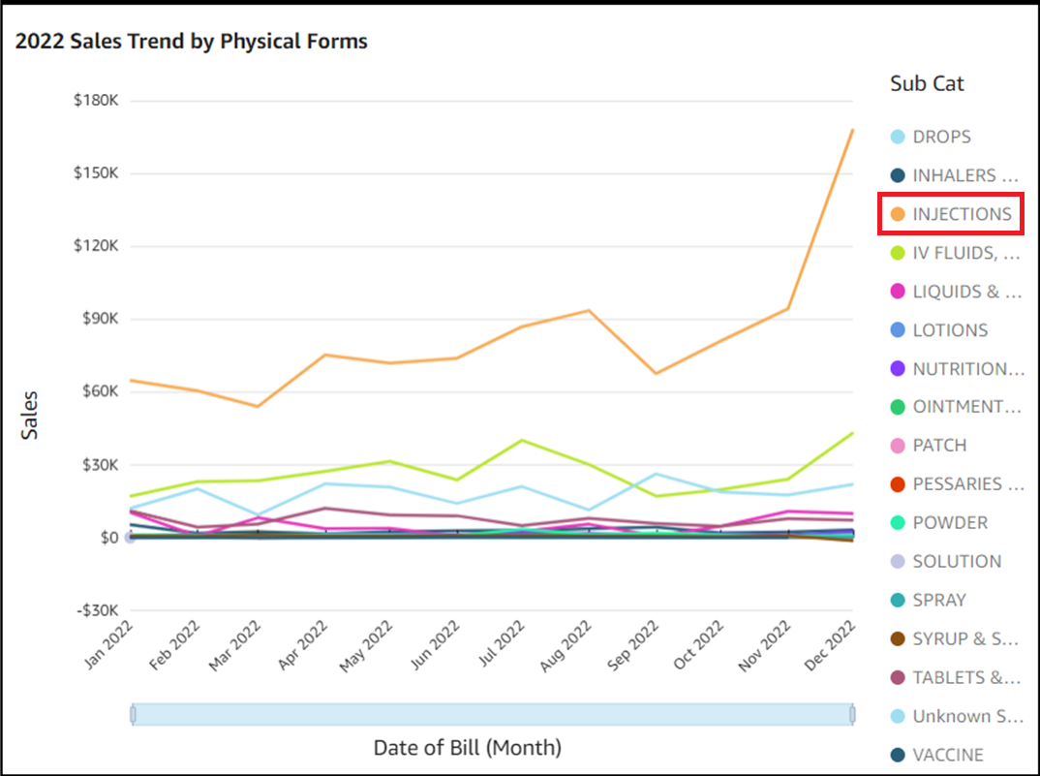
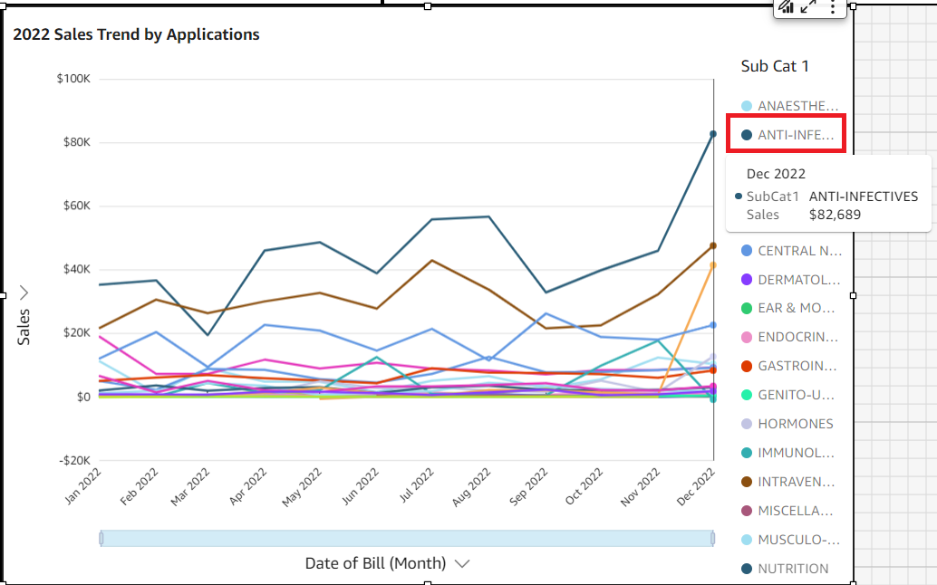
Data Visualization [Sales Trend]
Notes:
Piee

Slide 28
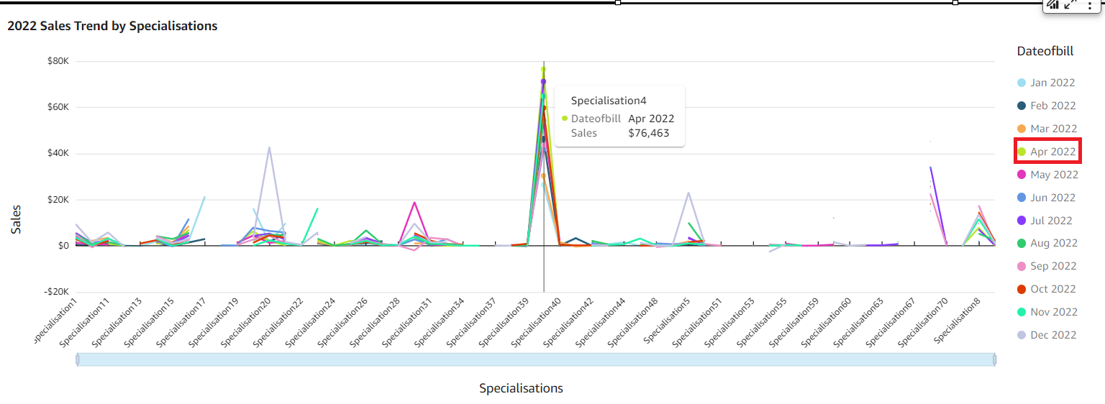
Data Visualization [Sales Trend]
Notes:
Piee

Slide 29
Data Visualization [Sales Trend]
In terms of specialisation and physical form, despite highest bounce rate, Specialisation 4 medicines and medicines of injections type were top 2022 sales contributors.
In terms of application, 2022 top seller were anti-infectives medicines.
Highest medicine sales month: December
Notes:
Piee

Slide 30
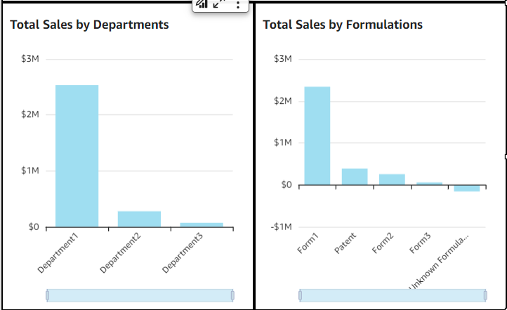
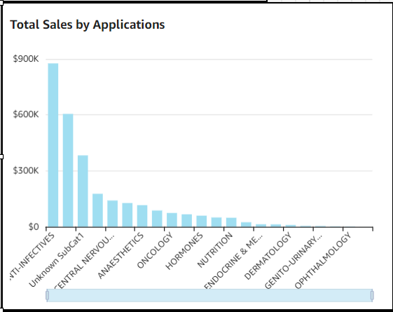
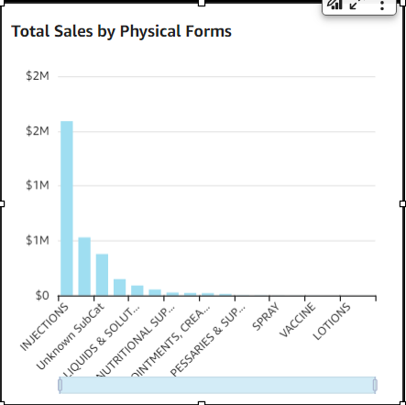
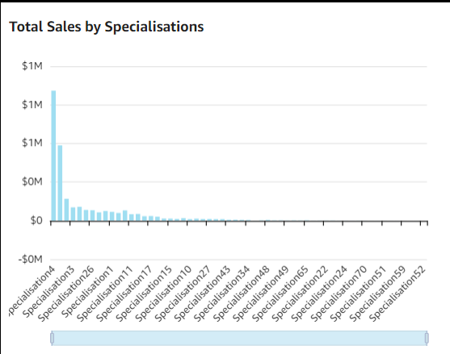
Data Visualization [Sales Group]
Bar chart to identify top and least seller of each groups:
Department:
Top seller: 1
Least seller: 3
Formulation:
Top seller: 1
Least seller: Unknown (-ve)
Application:
Top seller: Anti-infectives
Least seller:
Antidotes, detoxifying agents & drugs used in substance dependence
Physical Form:
Top seller: Injections
Least seller: Sachets
Notes:
Piee

Slide 31
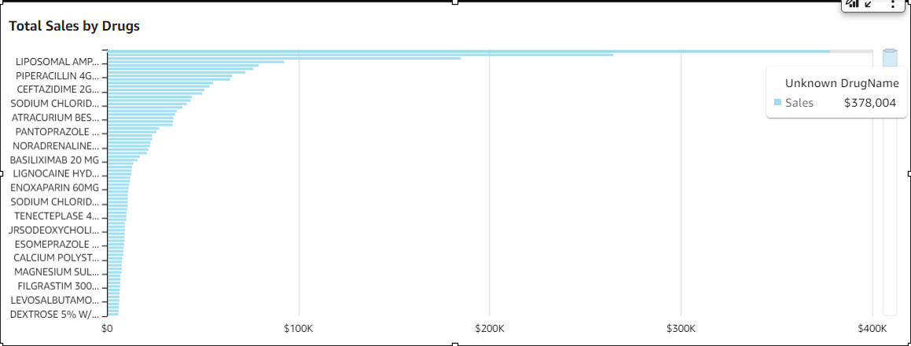
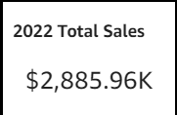
Data Visualization [Sales Group]
Specialisation:
Top seller: 4
Least seller: 52
Drug:
Top seller: Unknown drug
Least seller: Mycophenolate Mofetil 250mg/ml susp (-ve)
Sales total are highly right skewed in all groups. In each group, high sales total are contributed by a very few members of that group.
Sales and marketing campaign may be designed for medicines with Formulation 1 for Specialisation 4, which were sold by Department 1 in Injections form for Anti-infectives purpose, as medicines with these type of characteristics tend to sell great.
Notes:
Piee

Slide 32
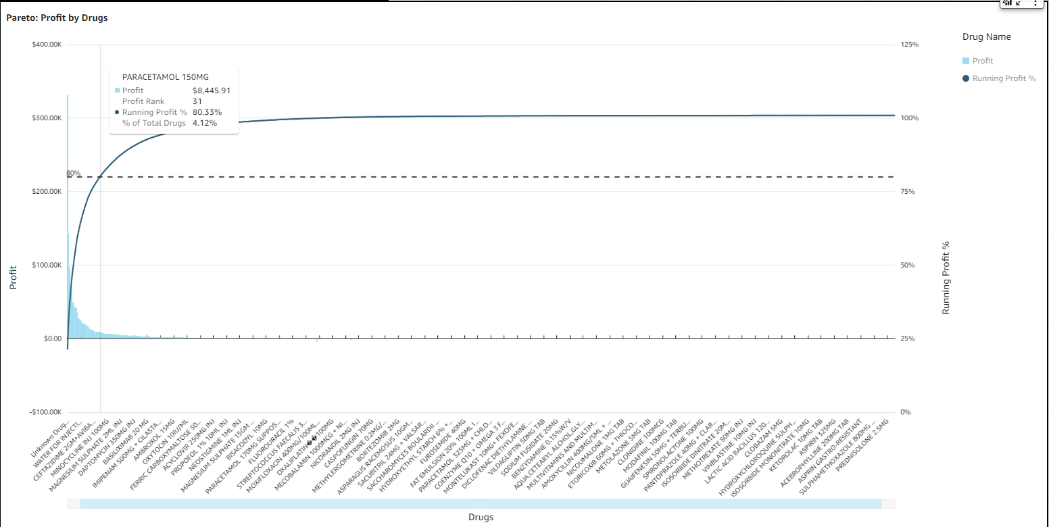
Data Visualization [Profit Pareto]
To gain 80% profit, focusing at the sales of these 4.12% medicines:
Notes:
Piee

Slide 33
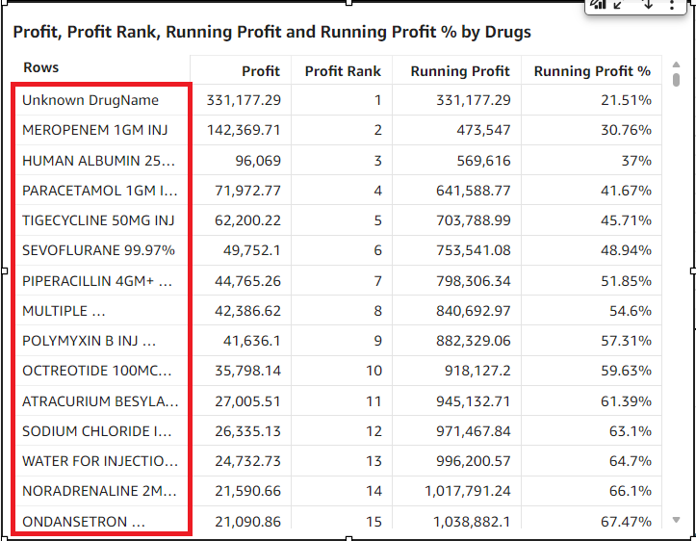
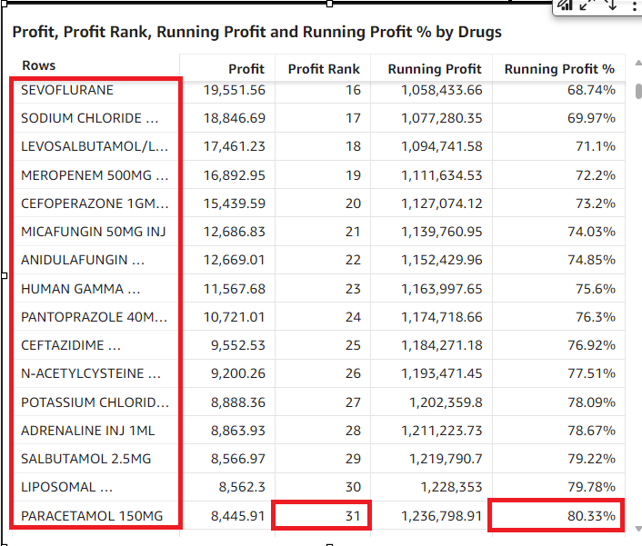
Data Visualization [Profit Pareto]
Top profit rank medicine is unknown (missing values).
Notes:
Piee

Slide 34
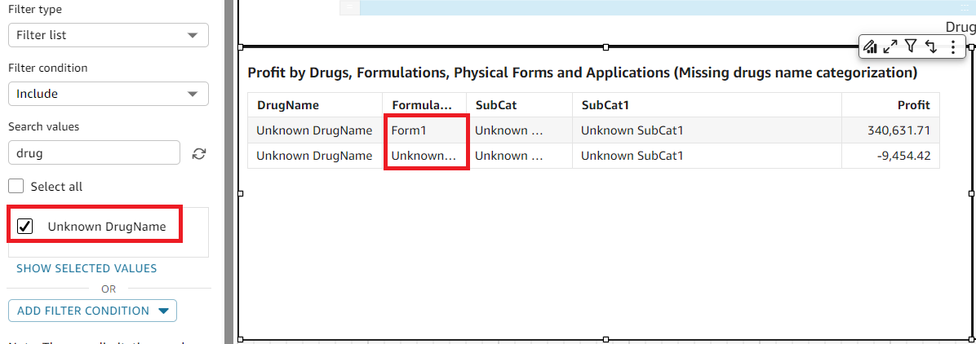
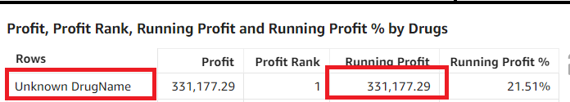
Data Visualization [Missing Medicine Names ]
As top profit rank medicine name is missing, a filter is applied to DrugName column, to categorize unknown medicines:
When DrugName = Unknown, Formulation = 1 (+ve profit) or Unknown (-ve profit)
The top profit rank unknown medicines has contributed a profit of $331K
As unknown medicines of unknown formula only gave a -$9K of lost, therefore, can conclude that majority of the sales contributing missing recorded name medicines are Formula 1 medicines.
Notes:
Piee

Slide 35
Future Scopes
Current medicine bounce rate is 12% as a whole. To further reduce medicine bounce, reason of bounce should be identify for an effective bounce reducing strategy formulation.
Sales and marketing campaign may be designed for medicines with Formulation 1 for Specialisation 4, which were sold by Department 1 in Injections form for Anti-infectives purpose, as from the analysis, medicines with these type of characteristics tend to sell great.
Sales and marketing campaign should be designed for medicines with the profit rank of 1st-31st in Pareto analysis, as sales of these medicines generate 80% of profit.
From the analysis, high bounce rate groups/medicines often high sales figure contributors. While sales efforts should be focused on these groups/medicines, bounce rate reducing strategies are equally important.

Slide 36


